Slide 1
Miami Lib Finder
Yixin Li, Wenkai Cao,
Yi Yang, Yangkai Zhang
Notes:
在最底下加一下演讲者

Slide 2

Project Stakeholder
Project Sponsor
Benzing Mattew - Best librarian
Meng Qu - King librarian
Project Instructor
Lynn Stahr
Technical Instructor
Vaskar Raychoudury
Project Team
Yixin Li
Wenkai Cao
Yi Yang
Yangkai Zhang

Slide 3
Project Scope
Project Background
Project Issue
Grid mapping system
A* Algorithm for indoor mapping
Map data
User interface
Next Semester milestone

Slide 4
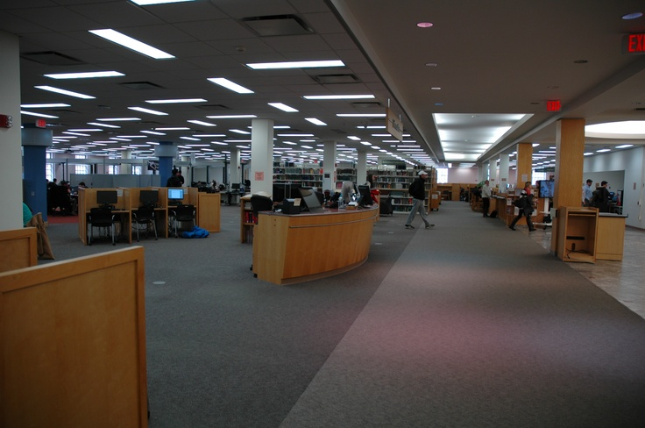
Project Background
Pain Point
Number of staff are limited
Visitors have trouble in finding books, study rooms and computers etc.
Purpose
Guiding the user to target location
Increasing the efficiency of navigation
Business case
Indoor navigation system would not charge any money for Miami University students and faculties.

Slide 5

Project Issue
Combine code written by javascript and C#
Implement function of map zoom in and out

Slide 6
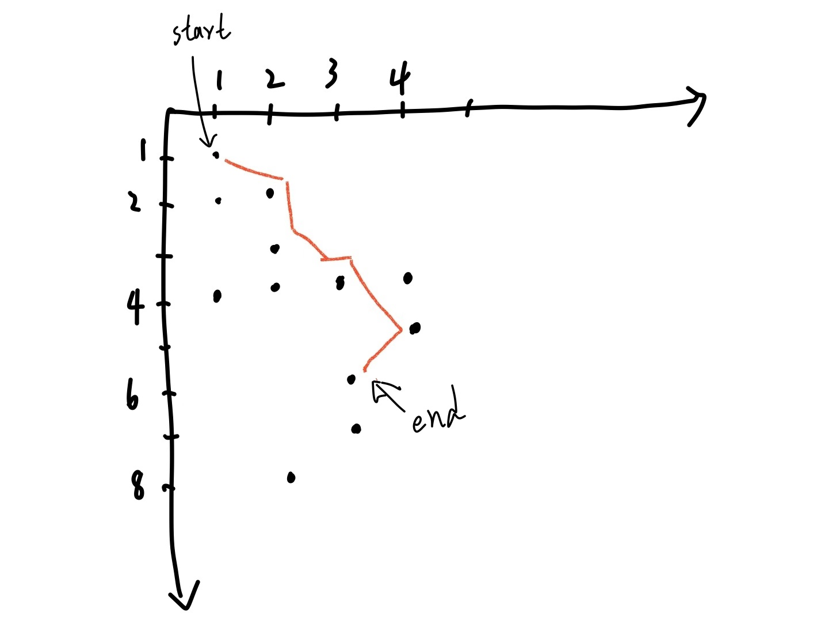
Grid Map System
(using A*)
Transfer precise map (pdf) into an algorithm readable data (as a coordinate system) by CAD
Apply data and query into algorithm to get path (consists of multiple points).

Slide 7
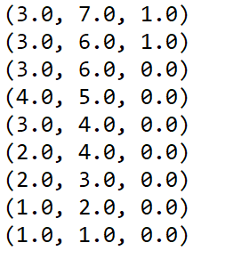
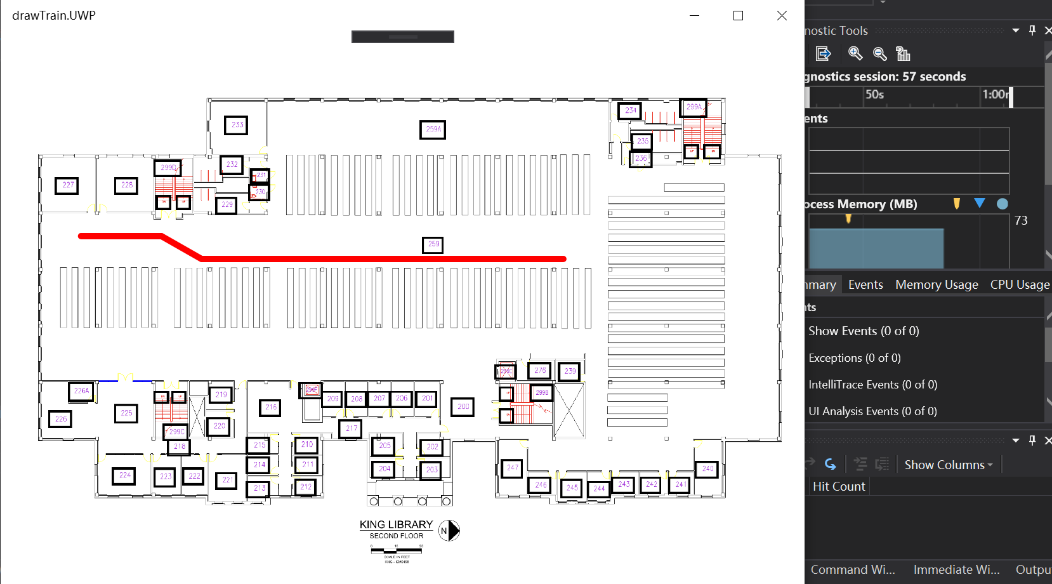
A* algorithm and pathline drawing
Output:

Slide 8
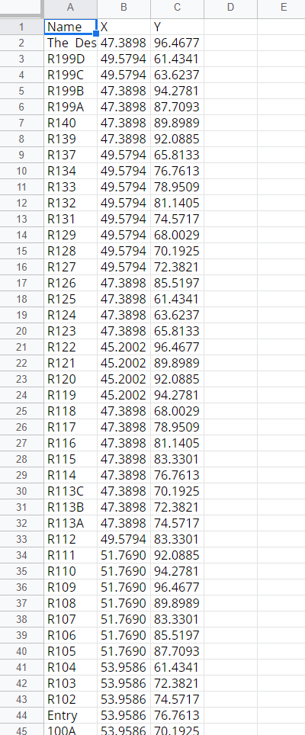
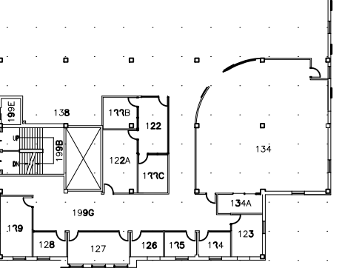
Map data
Insert a point of regular distribution on the graph
The distance between each point is based on the scale
each point has 8 points around to apply to the algorithm
Sample Data
Notes:
By Wenkai Cao

Slide 9
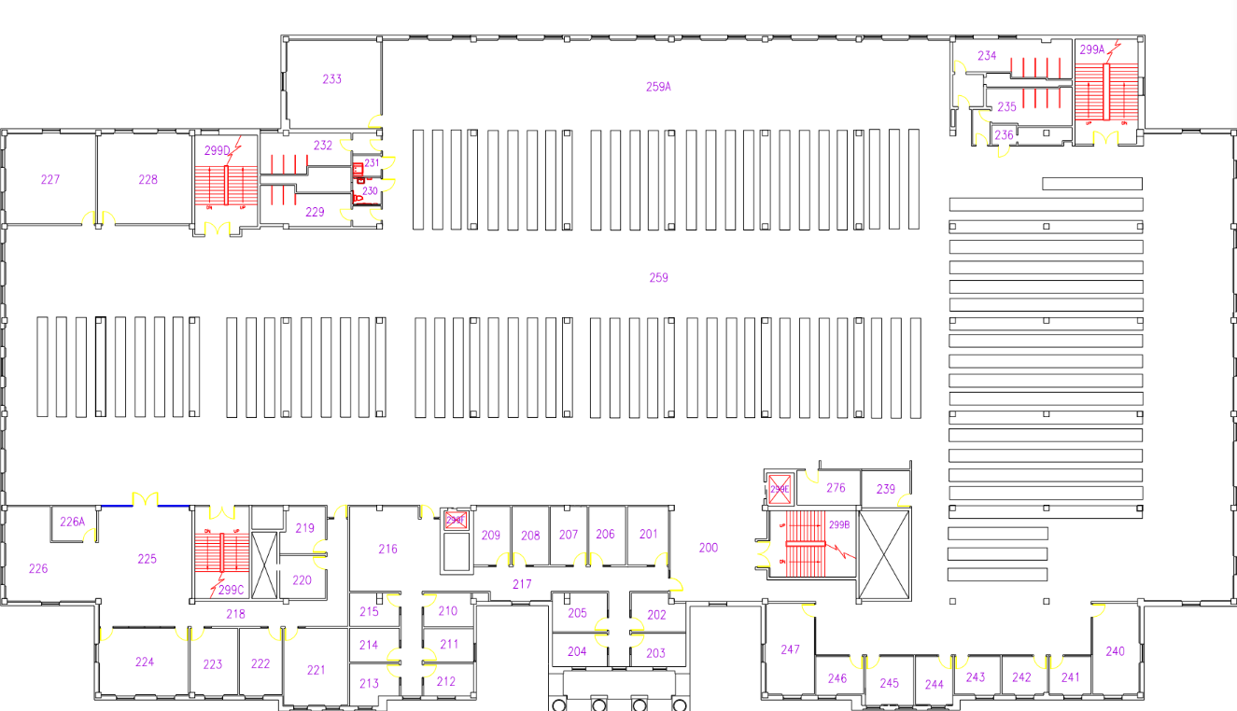
Map data
What is being done now
Draw the exact position of the bookshelf on the map and adjust the accuracy of the coordinate points as needed(10 ft now)
Alter the cad map to make it look better for using in the app
Add details to the map of the entire library (computers, printers, labs, etc.)
Notes:
By Wenkai Cao

Slide 10
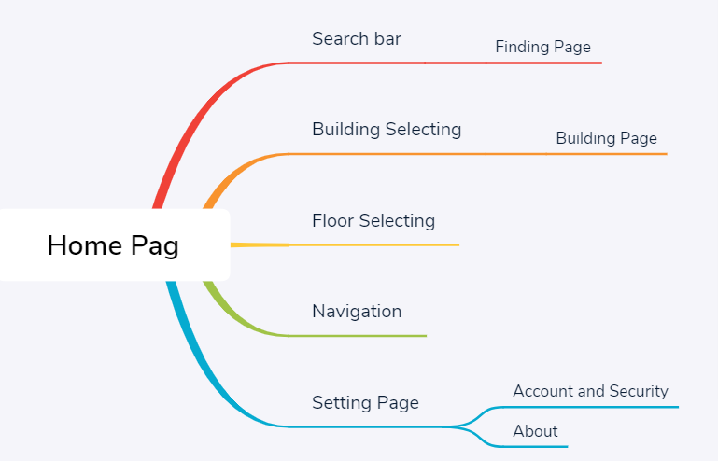
UI Design
First & Second Draft 10/23/2019
Member: Yi Yang, Yangkai Zhang
Third Draft(Done) 11/14/2019
Member: Yi Yang, Yangkai Zhang
Fourth Draft Expect: 11/24/2019
will be decided after today’s client meeting. (High percent to be the Final Draft)
Member: Yi Yang, Yangkai Zhang
Notes:
By Yi
About 1 minutes

Slide 11
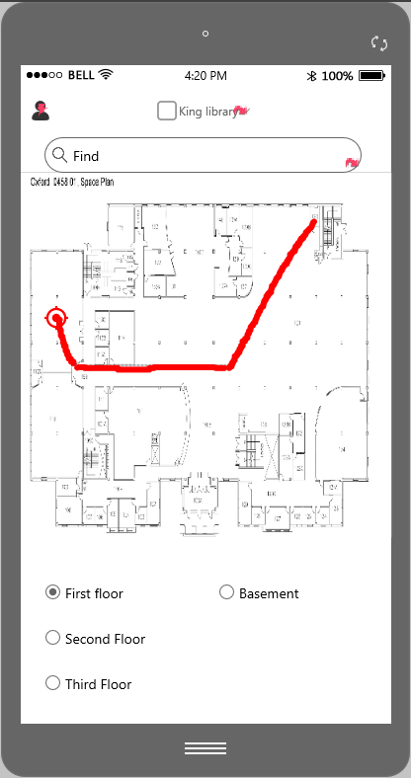
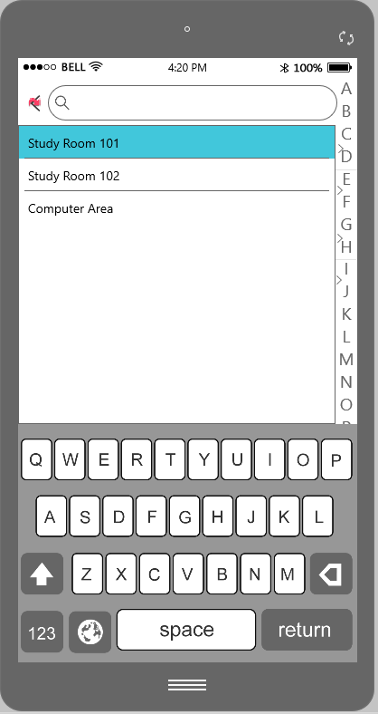
UI Design
Third Draft
Member: Yi Yang, Yangkai Zhang
Notes:
By Yi
About 1/2 minutes

Slide 12
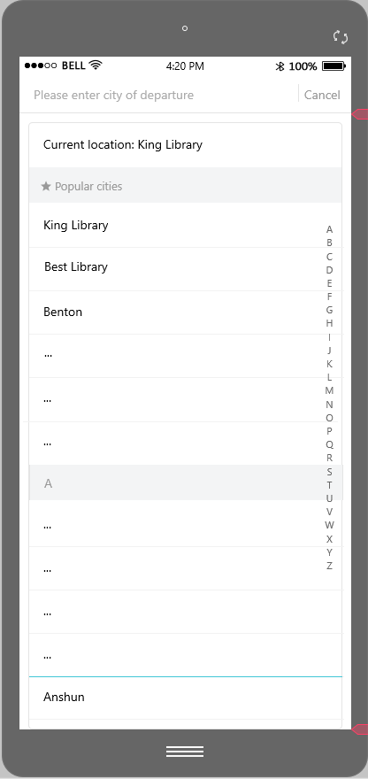
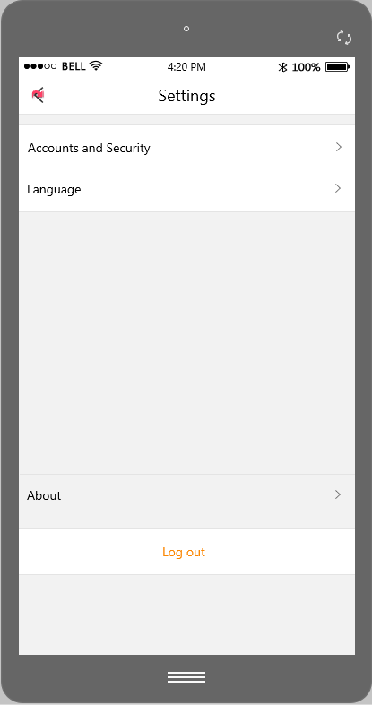
UI Design
Third Draft
Member: Yi Yang, Yangkai Zhang
Fourth Draft
Member: Yangkai Zhang, Yi Yang
Notes:
By Yi
About 1/2 minutes

Slide 13
Milestone for next semester
448
449
+
Implement the navigation between different floor
Implement Login System
Integrate all parts together, (mapping, pathline drawing, dynamic display, and )
Improve User Experience

